Slide 2
Agenda
Who am I?
What is Customer Success?
What has changed?
What new skills are needed in Customer Success?

Slide 3
About Me
Senior VP of CS and Fractional COO
I love startups! I've been part of 9!
Customer Success is not just my career, it's my hobby and passion!
4 exits and a couple of failed startups
Alumni of Lending Club (unicorn), HelloSign (acquired by Dropbox)
SuccessHacker Top 25 Customer Success Influencer for 2021 & 2022
Featured in four books talking about Customer Success
Avid hiker, mountain biker, documentary nerd, bad dad joke master
What new skills are needed in Customer Success?

Slide 4
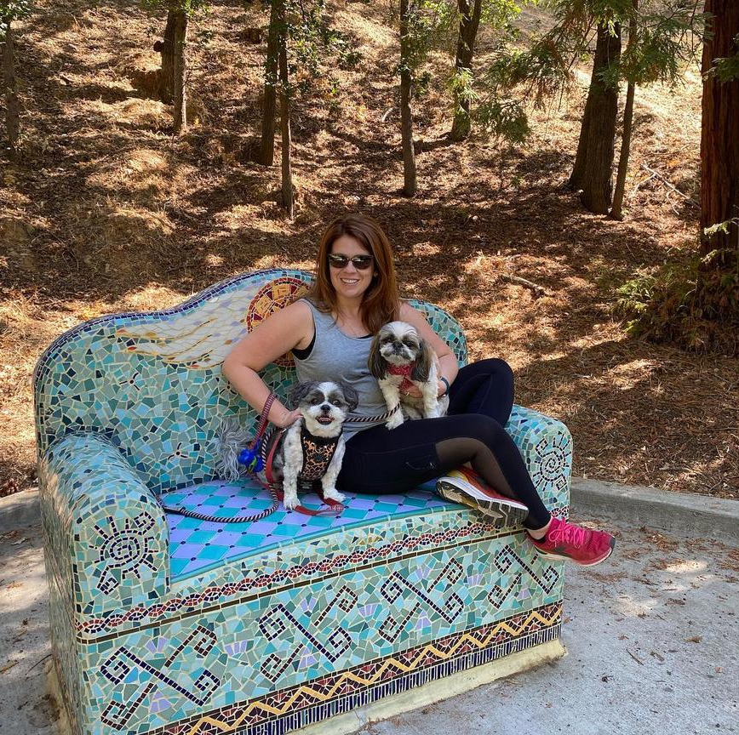
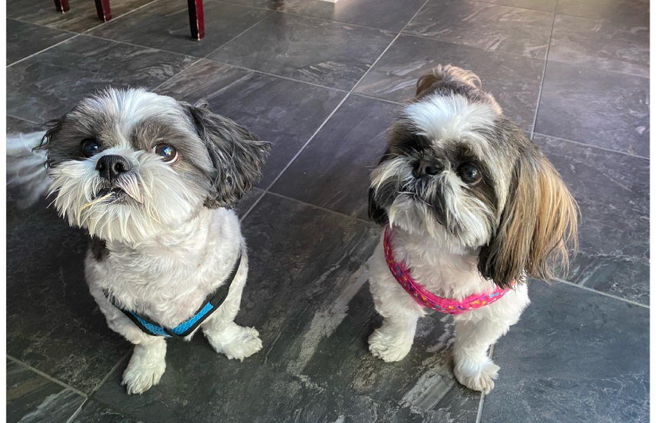
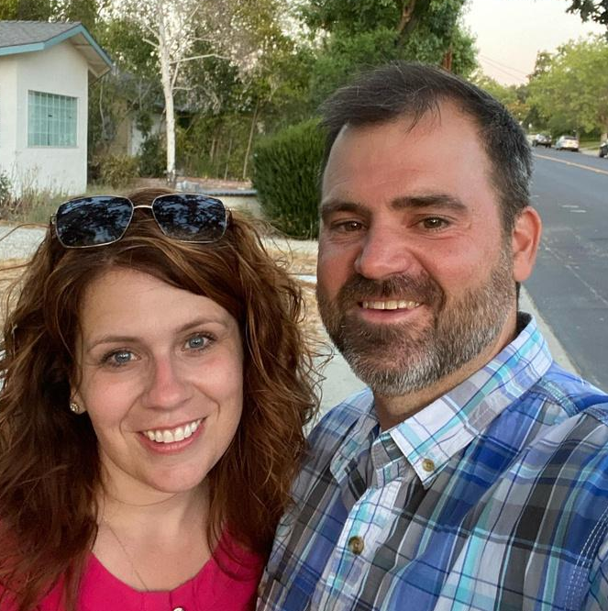
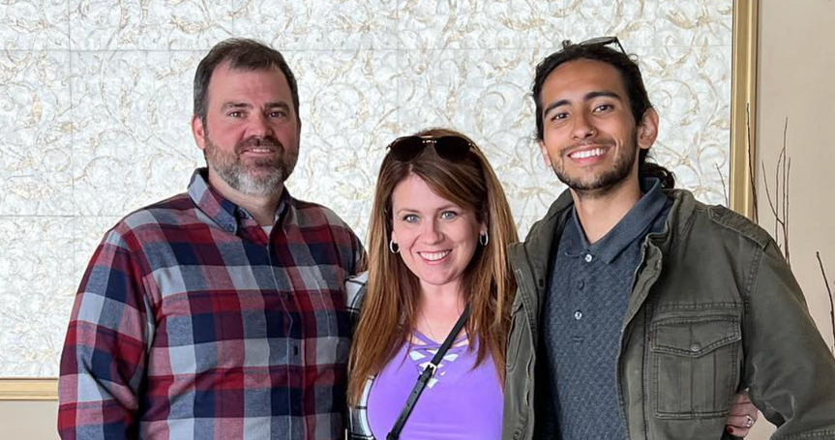
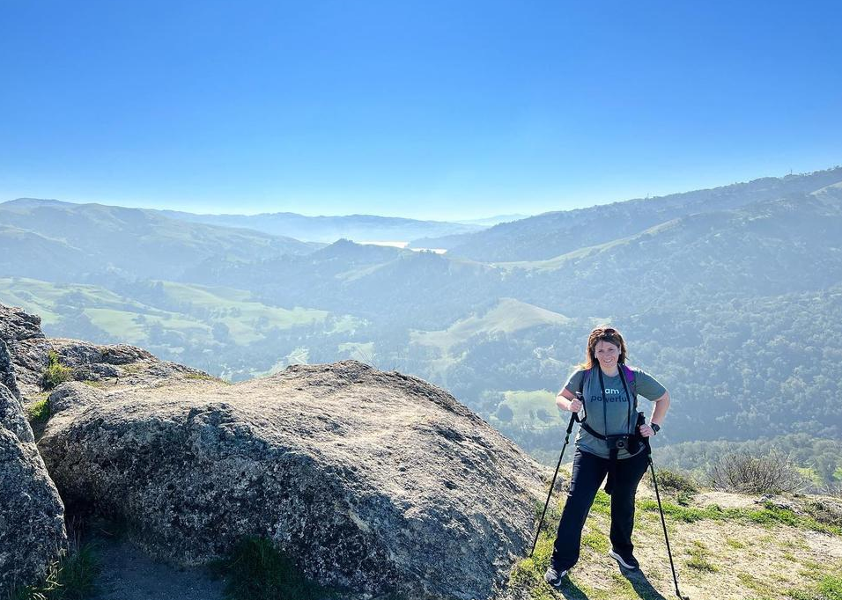
What new skills are needed in Customer Success?

Slide 5
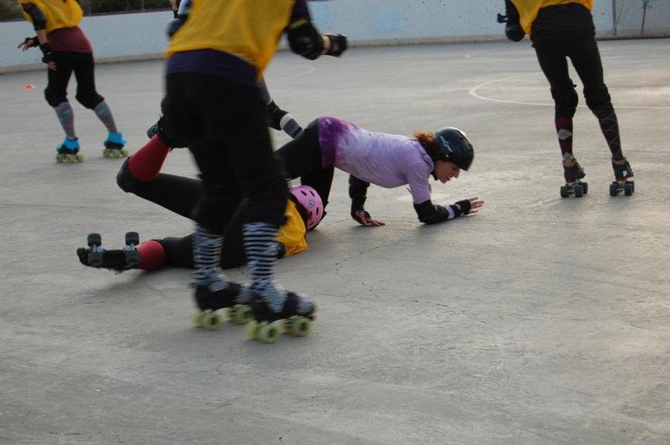
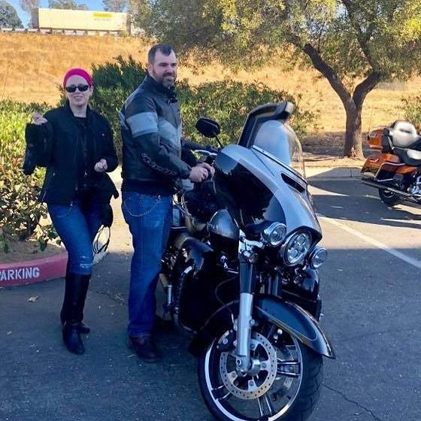
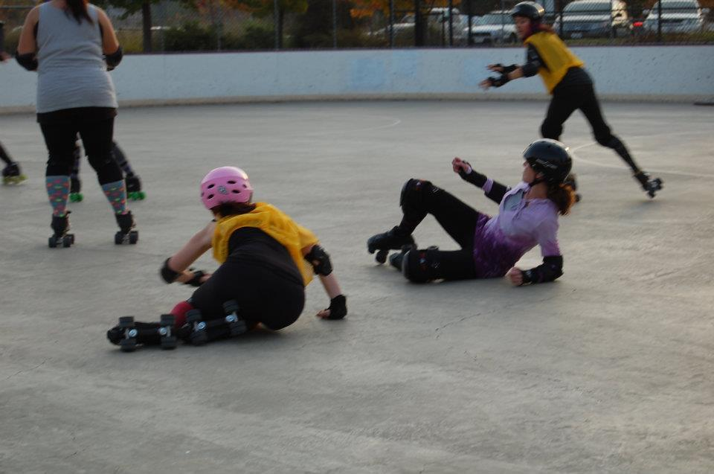
What new skills are needed in Customer Success?

Slide 6
WARNING: text heavy slides
What new skills are needed in Customer Success?

Slide 7
Level Setting on Customer Success
Customer Success, or the success of a customer is owned by the entire company and is achieved when customers realize their desired outcome through their interactions with your company, tool, or service.
Customer Success Management is a department within an organization that orchestrates certain activities to help customers achieve success again and again and again.
Customer Success Management is meaningless, unless the company is bought into the value of making the “right” customers successful.
What new skills are needed in Customer Success?

Slide 8
What does a CSM do?
Decreasing time to value
Increase LTV of customer base
Key players in the “land and expand” motion
Building out value cycles in partnership with customers, developing ROI, proactively managing relationship.
Drive stickiness through increasing adoption
Building key and strategic relationships
Create external advocates. References, case studies, webinars participants and so on.
Advise on “right fit customers”, product features.
What new skills are needed in Customer Success?

Slide 9
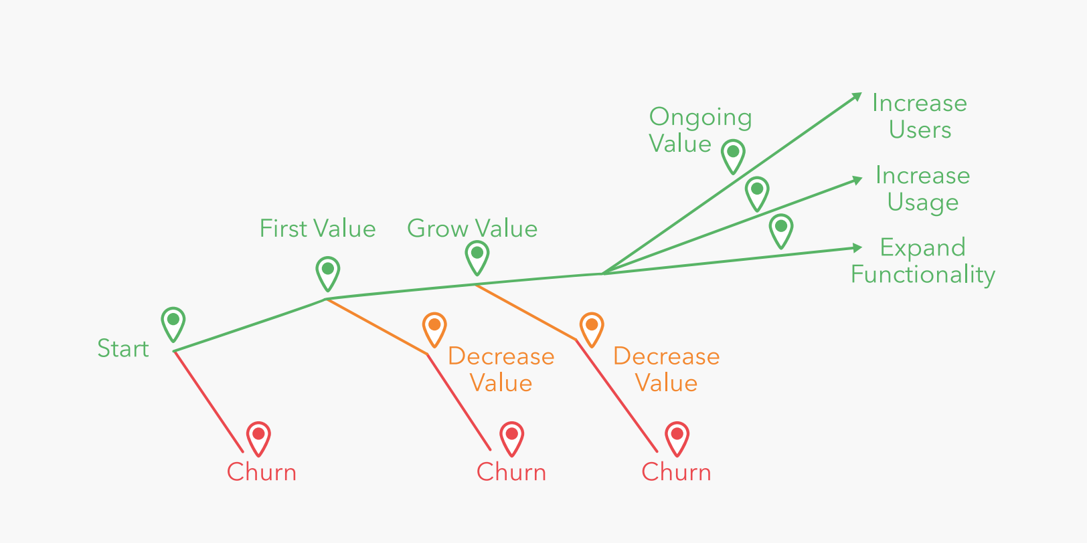
What does a CSM do?
-
What new skills are needed in Customer Success?

Slide 10
Some goals for CS
Every customer is achieving and knows they are achieving repeatable value on their investment
Every customer renews and grows with your company
Every customer becomes an advocate for your company
Examples: case studies, references, webinars, CAB
Every team member in CS understands the importance of why delivering value and outcomes are at the core of what we do.
We have a CS value machine
We have a seamless and orchestrated experience for the customer and everyone involved in the customer life cycle.
What new skills are needed in Customer Success?

Slide 11
What has changed?
What new skills are needed in Customer Success?

Slide 12
Everything
What new skills are needed in Customer Success?

Slide 13
Where should you invest?
Know your numbers
Know your business
Know what’s happening in your customers organization
Know your levers
What new skills are needed in Customer Success?

Slide 14
Value is king!
What new skills are needed in Customer Success?

Slide 15
Ideal Customer Journey
First-Touch
Purchase
First-Value
Adoption
Expansion
Renewal
Marketing
Sales
Implementations
Customer Success
CS and/or Sales
CS and/or Sales
Leverages Outcomes and Value stories for case studies, prospect targeting and future drip campaigns.
Starts introducing Outcomes and Value stories at the beginning of the life cycle. This carries throughout the duration of the relationship.
Leverages the established problem statements and identified goals to center training and change management.
Strategically partners with the customer to make sure that they achieve desired outcomes and value on their investment.
Actively partners with the customer to identify future use cases to continue to build up a strong ROI story.
Leverages all ROI and Value Stories collected during the duration of the life cycle to help power a strong renewal.
What new skills are needed in Customer Success?

Slide 16
Enterprise Value Cycle
Understand Goals and Pain Points
Focus on value delivery and ROI
Strategically move customers through the value cycle.
Top X ARR accounts have account (success) plans
At-Risk Success Plans
All medium and high risk agencies will have an “at-risk” account plan that tells the story of how we are planning to move them to green
Expand stakeholders/executive sponsors at each account
Partnering with key stakeholders at initial onset of the relationship and throughout to help us expand use cases within the account.
Identifying other stakeholders that we want to engage with as part of the account plan will help with renewed focus of this initiative.
Increase stickiness and adoption
Heavy focus around stickiness and adoption by persona, use cases and/or product
Partner with account to uncover problem statements. Both known and unknown.
Report on Value
Build a Plan
Through regular touchpoints and EBRs, report on value.
Create and document a plan of action. Execute.
Deliver Value
- Drive plans to completion and uncover value and outcomes.
- Share any product enhancements.
What new skills are needed in Customer Success?

Slide 17
Questions ?
What new skills are needed in Customer Success?

Slide 18
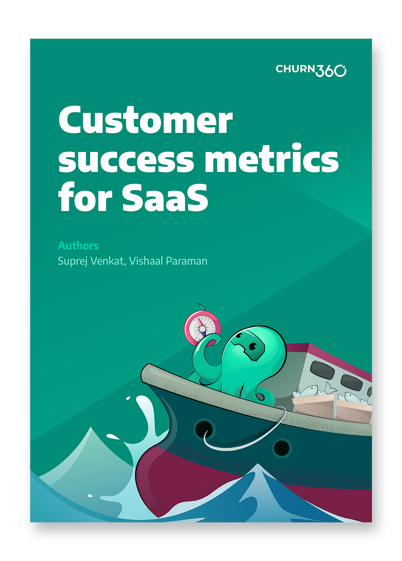
A Surprise Giveaway!
What new skills are needed in Customer Success?

Slide 19
Thank You!
What new skills are needed in Customer Success?

