Slide 1
From Data to Dollars:
Optimizing B2B Business with Customer Segmentation
Presented by:
Kristen Hayer
CEO, The Success League

Slide 2
Agenda
Why Segmentation?
Building Actionable Segments
Segmentation Examples
Segments in Sales & Marketing
Measuring Revenue Impact by Segment
Segmentation Best Practices
© 2023 The Success League, LLC

Slide 3
Why Segmentation?
What is it?
Breaking your customer base into groups that have similar needs at a similar price point.
Why is it important?
Meets customer needs in the way they want them met.
Aligns cost and revenue.
Allows for reporting and decision-making that is unique to each customer group.
© 2023 The Success League, LLC
Notes:
Customer Story:
Customer was an early-stage company, focused on what they thought their major value-driver was, reducing employee turnover
They were great at getting companies into their pilot program, but almost every customer churned after the pilot was over
We were hired to help figure out what was going on
When we interviewed their customers, we found that almost every client had a different reason for choosing the product initially
None of them chose it because they wanted to reduce turnover
The company’s messaging and measurements were wrong, which resulted in customers deciding they weren’t seeing enough value
Segmenting customers by not only revenue but behavior and value helps to minimize this kind of mistake

Slide 4
Building Actionable Segments
ARR + Brand Value
Aligns segmentation with business model
Allows for manual assignment of major brands
X Factor
Major driver of customer behavior differences
ARR + Brand Value
X Factor
© 2023 The Success League, LLC
Notes:
What is the X Factor?
It can be anything that creates a dimension to customer care that is different from revenue.
When working with our clients this has been everything:
Available whitespace
Complexity of integrations
Vertical
Geography
Level of technical expertise
Dedicated resource
It is whatever FOR YOUR COMAPANY makes customers behave differently and need a different level of help.

Slide 5
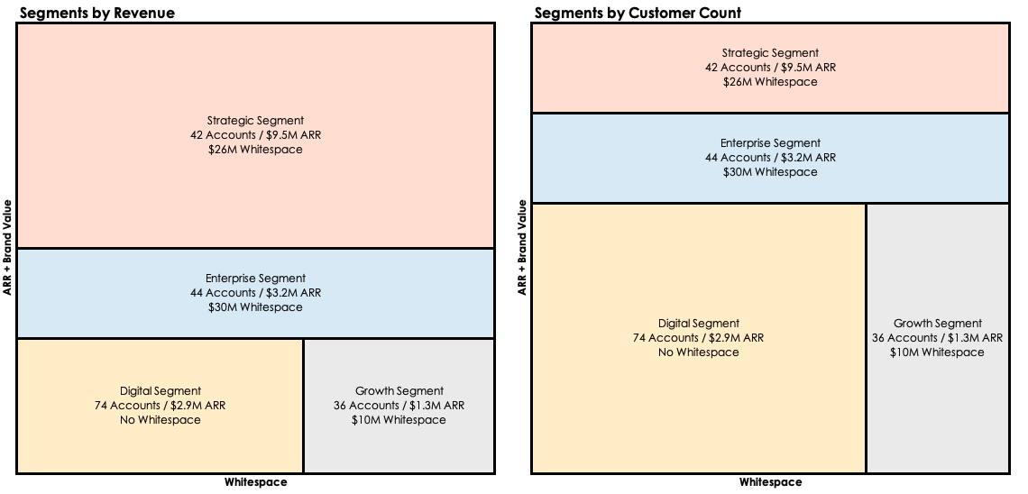
Segmentation Example 1
© 2023 The Success League, LLC
Notes:
Company:
Mature
Customers are Major Consumer Brands (Proctor & Gamble, Nestle)
Price Point is High with Wide Variation ($100k - $1.5M ARR)
High-Touch Program with major focus on expansion
Once the product is set up, customers are unlikely to churn
Major Behavior Driver = Available Whitespace
The company’s pricing model is based on the number of products a consumer brand is using the solution for
It is easy to determine the number of remaining products that are not on the solution
A major initiative of the CS organization is to expand into new product lines

Slide 6
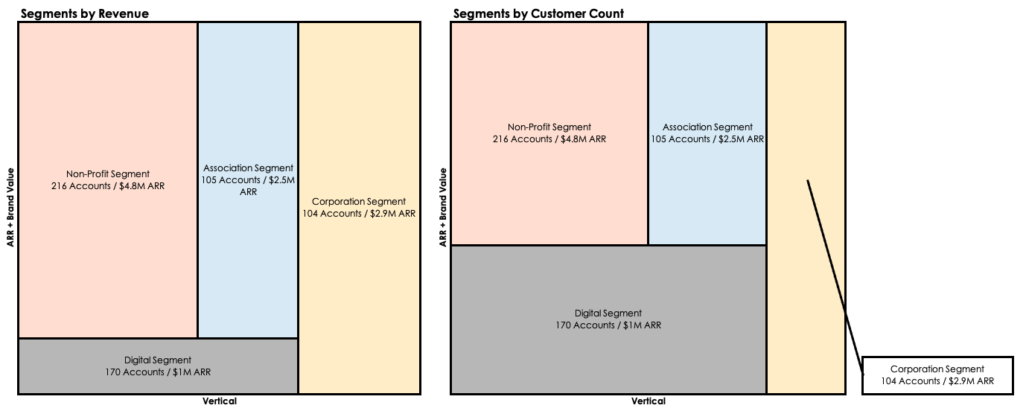
Segmentation Example 2
© 2023 The Success League, LLC
Notes:
Company:
Growth-Stage, 2 Recent Acquisitions
Customers are Advocacy and Government Relations Teams in Various Types of Organizations
Price Point is Mid-Level with Wide Variation ($10k - $200k ARR)
Both High-Touch and Digital Programs
Major Behavior Driver = Vertical
Different verticals need different solutions, and use the services for significantly different use cases
Example: Non-profits need to continuously drive advocacy, Corporations are driven by specific pieces of legislation, and Associations are highly seasonal.

Slide 7
Segments in Sales & Marketing
Use Cases by Segment
Product marketing can leverage unique use cases to develop solutions that appeal to different segments.
Value by Segment
Sales and Marketing can identify what different customer segments value and tailor messaging accordingly.
Advocates by Segment
Marketing can use different customer stories by segment to reach different types of customers.
© 2023 The Success League, LLC
Notes:
Talk through slide

Slide 8
Measuring Revenue Impact by Segment
Example: Churn x Segment and Risk Score
© 2023 The Success League, LLC
Notes:
So, what can you learn here?
Very little churn is coming from the Small Enterprise segment (SME)
A little churn is coming from the SMB segment, but it isn’t showing up in the churn score as high risk
Most of the churn is coming from the VSB or very small business segment, both in terms of customer count and revenue
What might you consider doing?
-Adjusting the churn scoring system for your SMB segment – obviously something is off. Research the churn that is coming from the green and yellow segments and then make changes.
-Discuss the VSB segment. Are there easy changes you could make? Or should you not worry about this segment and allow churn?
This is just one type of report that could come out of segmentation. Consider all of the reports you review with your leadership team. Which would benefit from the added dimension of segments?

Slide 9
Segmentation Best Practices
Choose 2-5 segments. Remember, every segment represents a different journey, and you don’t want to have to manage too many journeys or teams.
Review cross-functionally. Every team is going to have a different perspective, and you can learn from the vision of other teams.
Consider reporting. While you’re building your segments, think about what your existing reporting would look like broken down by segment. Does it make sense?
© 2023 The Success League, LLC
Notes:
Review slides

Slide 10
Q&A
Kristen Hayer
Kristen@TheSuccessLeague.io
LinkedIn @KristenHayer
Sign up for our free, weekly Newsletter:
TheSuccessLeague.io/CSblog

