Slide 2
A Process
Inputs
Transformation
Outputs
People
Methods
Materials
Equipment
Environment
Information
Volume
Time
Cost
Quality
How to lead effective change and adoption in customer success

Slide 3
Example
How to lead effective change and adoption in customer success

Slide 4
Symptoms
• Disengagement
• Complaining
• Absenteeism
• Frustration
• Delays
• Anger
• Hoarding information
• Cynicism
• Questioning everything
• Sabotage
How to lead effective change and adoption in customer success

Slide 5
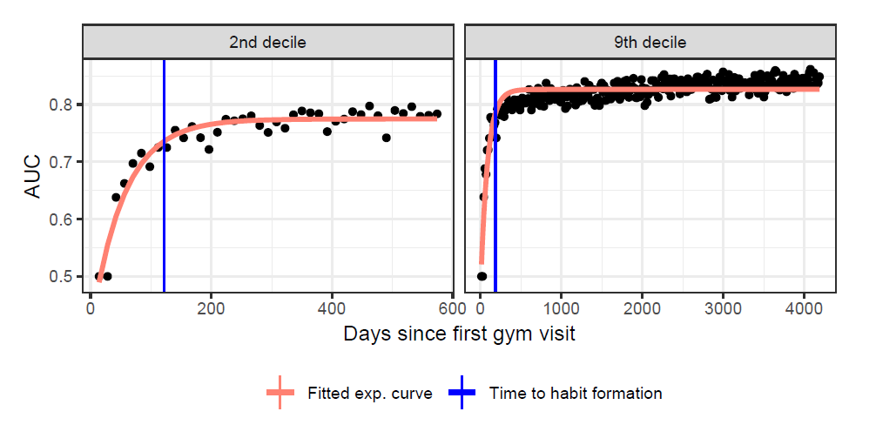
Time to Form Habits
Gym Membership : 4-7 months
Hand Washing : 9-10 shifts
Source: Buyalskayaa, A., Ho, H., Milkman, K., Li, X., Duckworth, A., Camerer, C. (2023). What can machine learning teach us about habit formation? Evidence from exercise and hygiene. PNAS, https://doi.org/10.1073/pnas.2216115120
How to lead effective change and adoption in customer success

Slide 6
ADKAR Model on a Page
How to lead effective change and adoption in customer success

Slide 7
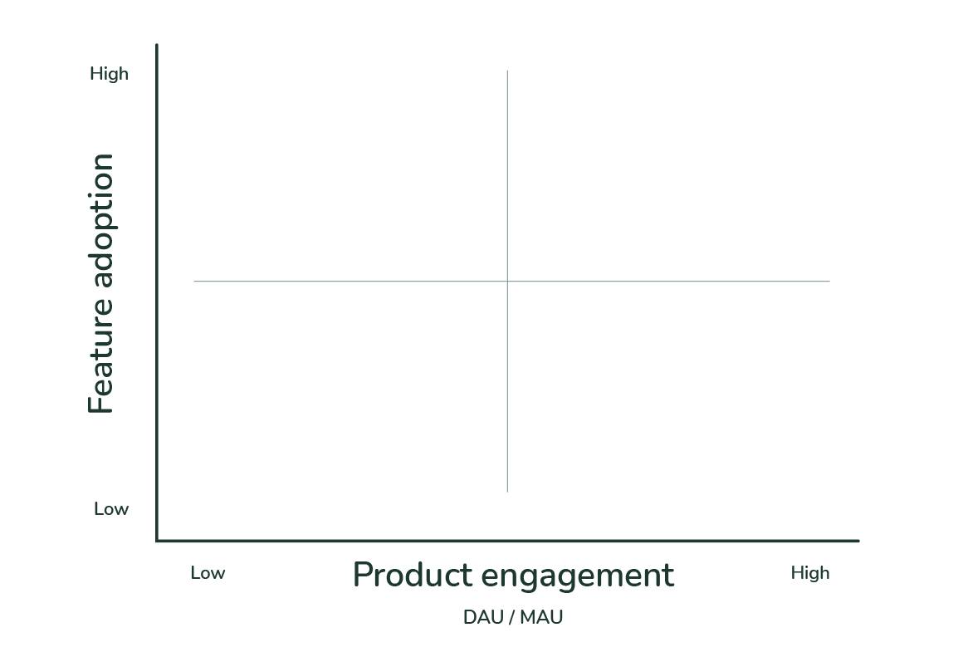
Churn360 Metrics
How to lead effective change and adoption in customer success

Slide 8
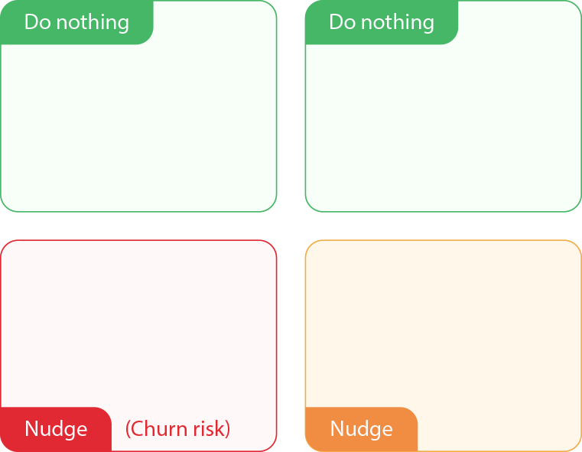
Churn360 Metrics
How to lead effective change and adoption in customer success

Slide 9
Churn360 Metrics
How to lead effective change and adoption in customer success

Slide 10
Q&A Session

Slide 11
Thank You
How to lead effective change and adoption in customer success

